Slide 1
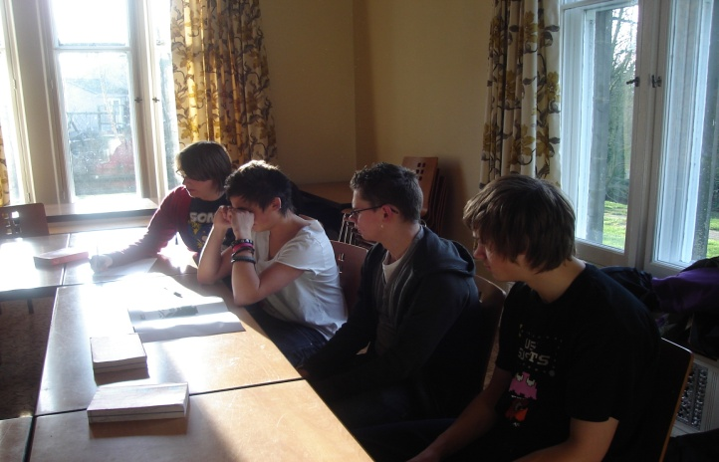
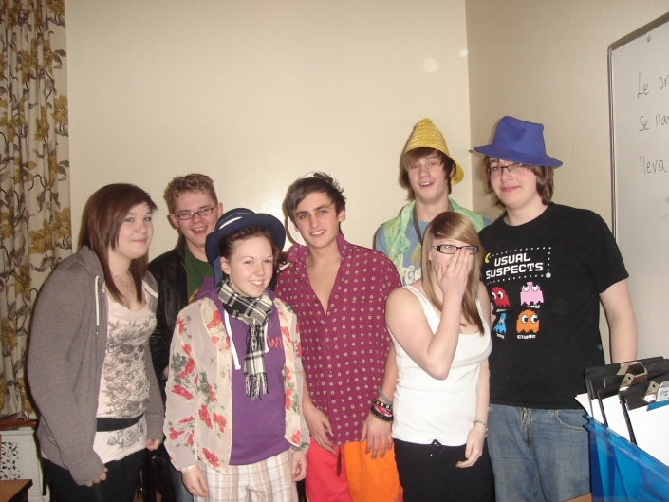
Spanish Revision Weekend
A group of Year 11 Spanish students spent the weekend 12&13 February at Haworth Youth Hostel in order to revise and prepare themselves for their forthcoming Spanish GCSE exam.
They spent the weekend doing various vocabulary activities as well as completing a quiz in Spanish around Haworth village.

Slide 2
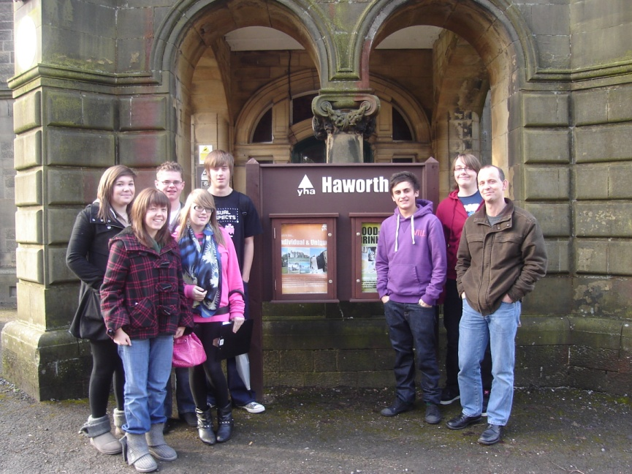
Mr Werth and Mrs Otterburn, who accompanied the trip, said it was a massive success which was mainly due to the hard work and involvement of all the students who took part.
Mrs Otterburn would like to thank all the students for their excellent behaviour and hard work-they were a credit to the school!

